Slide 1
Heat Map

Slide 2
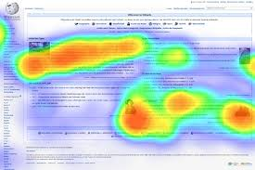
What is Heat map
A heat map is a two-dimensional representation of data in which values are represented by colors.
A simple heat map provides an immediate visual summary of information.

Slide 3
Color Scheme of heat map
A heat map uses a warm-to-cool color spectrum
Many different color schemes can be used to illustrate the heat map, with perceptual advantages and disadvantages for each.
How to select a color scale:
When it comes to heat maps, the two most common ranges of colors are sequential and diverging scales.
Sequential scales: Uses the blended progression, typically of a single hue, from the least to the most opaque shades, representing low to high values.
Diverging scales, on the other hand, show color progression in two directions: gradually toning down the first hue from one end to a neutral color at the midpoint, then increasing the opacity of the second hue to the other end of the scale.
Find a colour-blind -friendly combination, Five percent of the entire population is color blinded
Blue & orange
Blue & red
Blue & brown

Slide 4
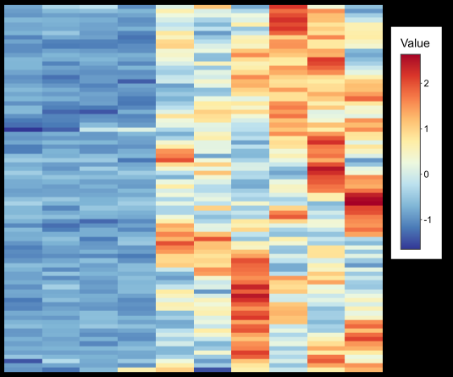
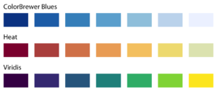
Color Scheme of heat map
Sequential Scale
Diverging scale

Slide 5
When to use Heat map
The primary purpose of Heat Maps is to better visualize the volume of locations/events within a dataset and assist in directing viewers towards areas on data visualizations that matter most.
Some of the use cases of heat maps are
Website Analysis
Retail Analytics
Operation Analytics
Population Map
Football Analysis

Slide 6
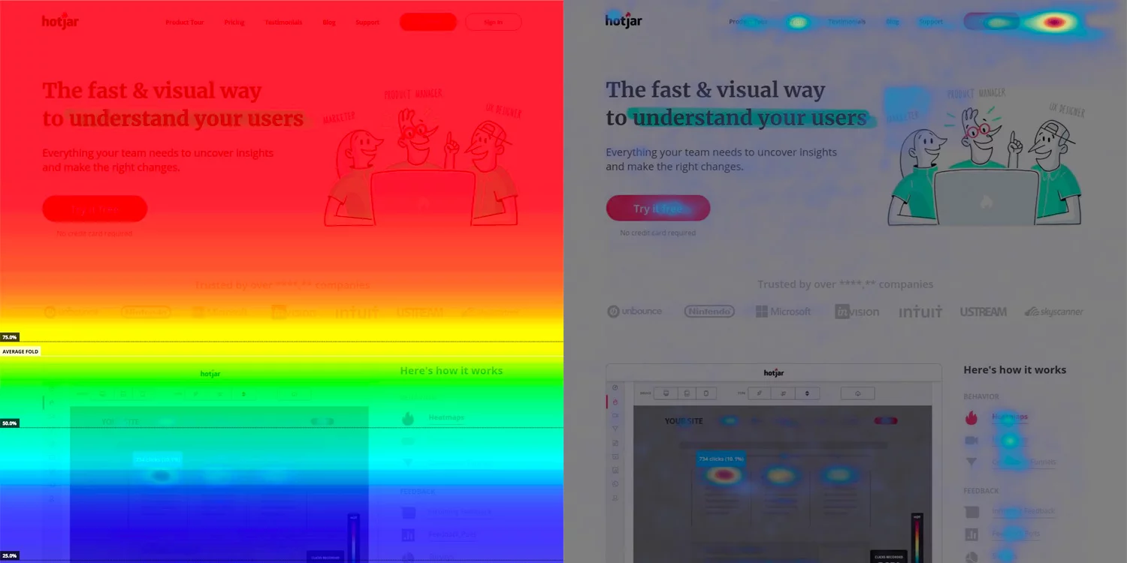
Heat Maps in website analysis
Heat maps usually display the average fold i.e. which is the portion of the page people see on their screen without scrolling as soon as they land on it.
Heat map is really an umbrella term for different heat mapping tools: scroll maps, click maps, and move maps.

Slide 7
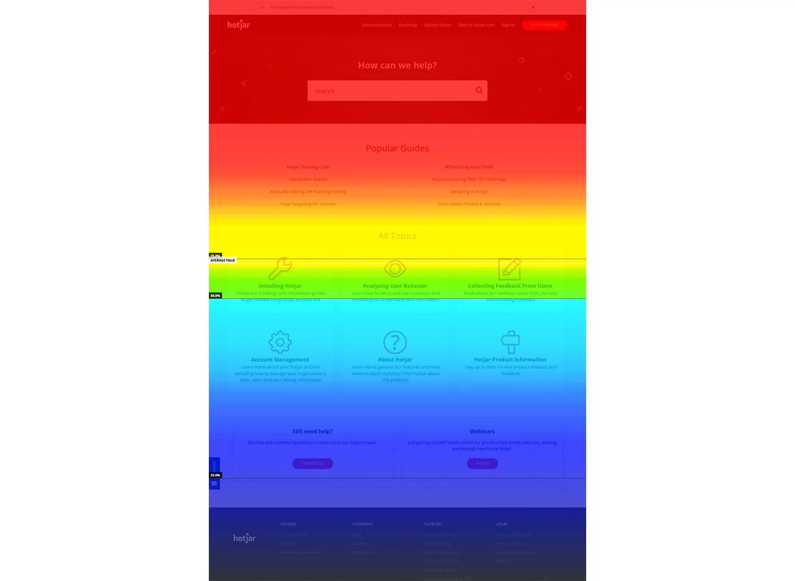
Scroll Maps
Scroll maps show you the exact percentage of people who scroll down to any point on the page
The redder the area, the more visitors saw it.

Slide 8
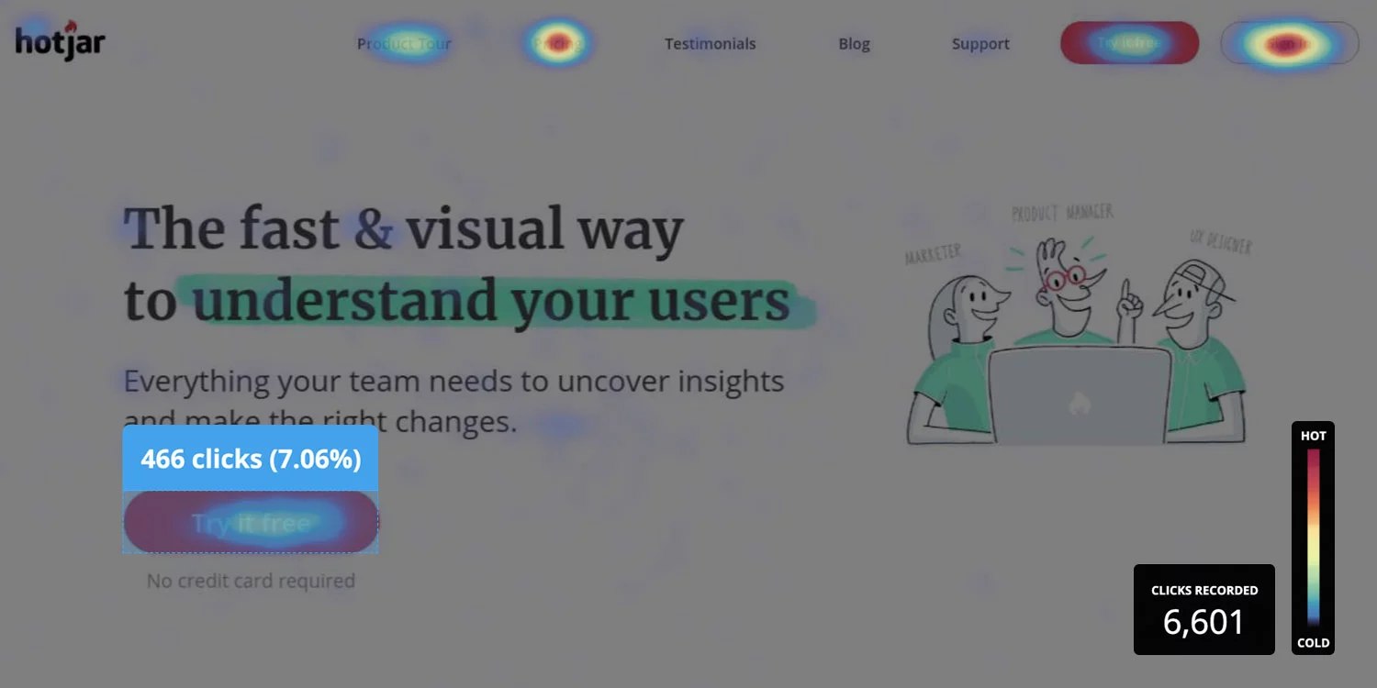
Click Maps
Click maps show you an aggregate of where visitors click their mouse on desktop devices and tap their finger on mobile devices.
Also known as touch heat maps.
The map is color-coded to show the elements that have been clicked and tapped the most (red, orange, yellow)

Slide 9
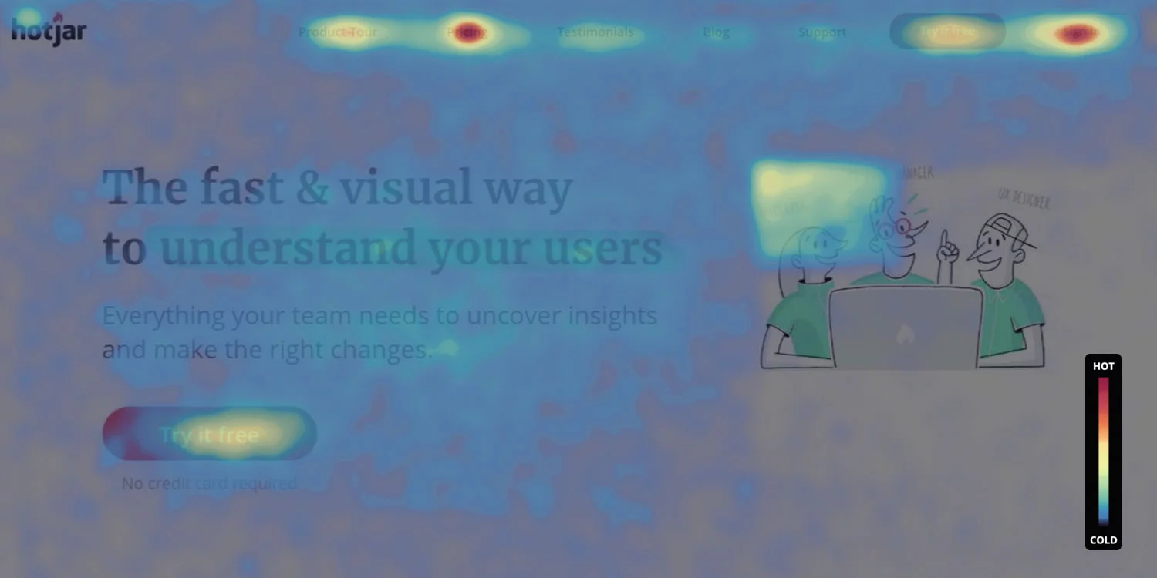
Move Maps
Move maps track where desktop users move and pause their mouse as they navigate the page.
The ‘hot’ spots in a move map represent where users pause their mouse, and research suggests a correlation between where people are looking and where their mouse is—meaning that a move map gives you an indication of where people might be looking as they go through your page.

Slide 10
Heat Map in Retail Analytics
In Retail the heat map help the Retailers in many ways like; It helps in knowing the hot spots, Dead areas, Bottlenecks

Slide 11
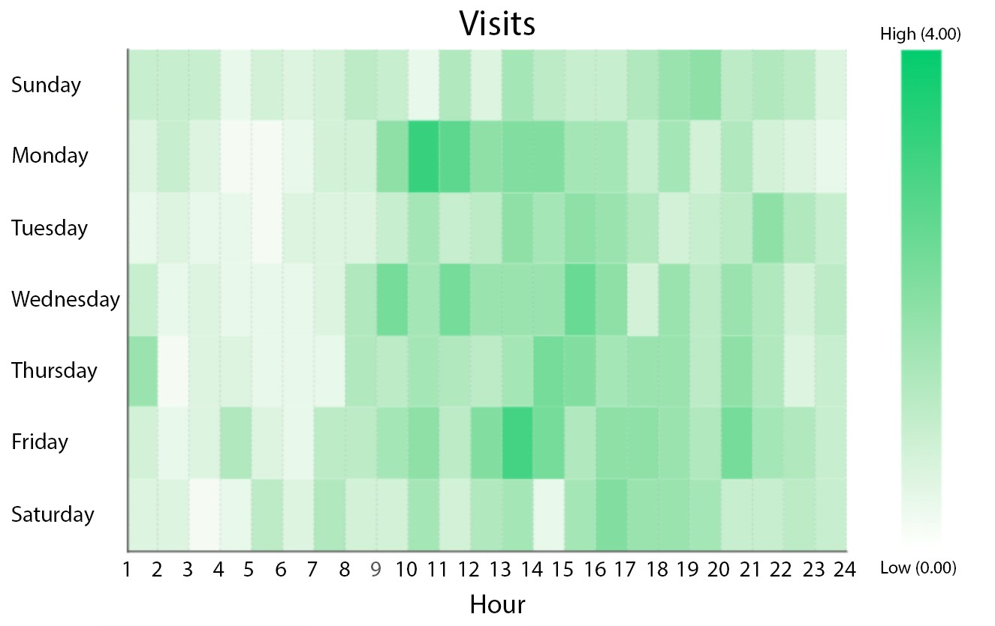
Retail Matrix heat map

Slide 12
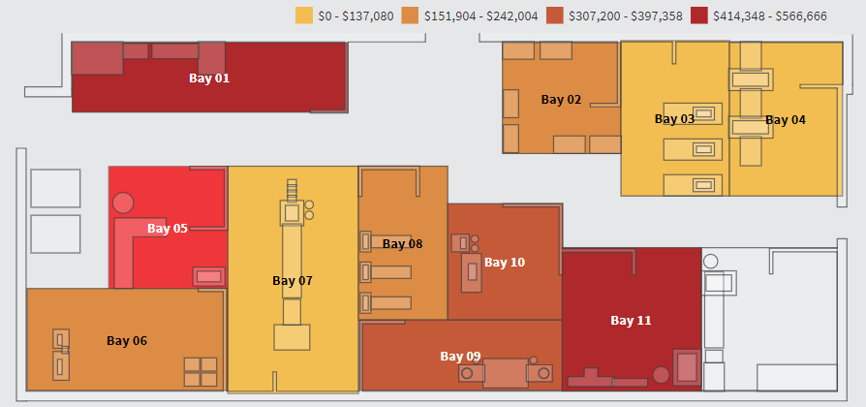
Heat map in Operation Analytics

Slide 13
Heat map in Operation Analytics
The Diagram of a multi-bay production facility, is displaying which production bays are contributing the most defects from a monetary perspective.
In this example, the darker the production bay, the higher the loss attributable to defects.
It’s easy to immediately see that production bays 1 and 11 are producing defects at an alarming rate, while production bays 3, 4, and 7 are performing within their expected thresholds.

Slide 14
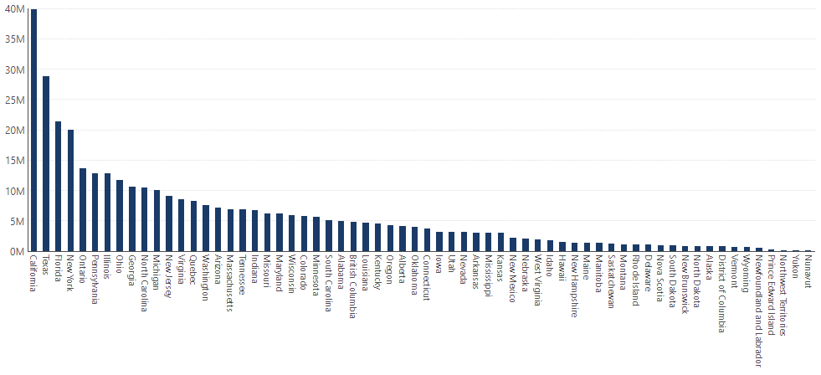
Populations of American states and Canadian provinces

Slide 15
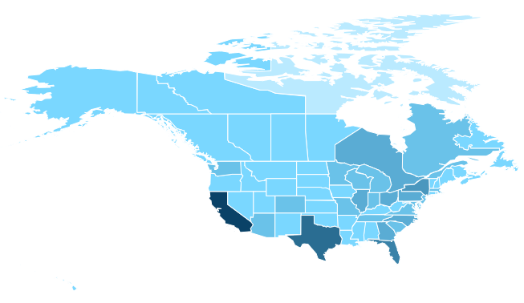
Population maps
Heat Maps can be used to represent population density, per-capita income, average temperatures, and so on.

Slide 16
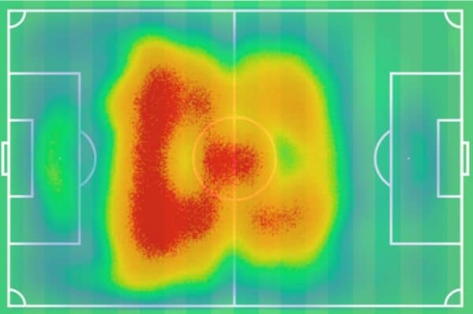
Heat map in Football Analysis

Slide 17
Tools for generating Heat map
Heat map can be generated from any one of the following tools and programming languages which we learnt
Tableau
PowerBI
Excel
R
Python
Apart from they are few free software as well
Hotjar
Crazy Egg
Fullstory
Heatmap.com

Slide 18
References
https://www.hotjar.com/heatmaps
https://mopinion.com/heatmapping-tools-you-might-want-to-try/
https://www.dundas.com/resources/dundas-data-visualization-blog/when-and-why-to-use-heat-maps
https://www.slideshare.net/surveyanalytics/feature-spotlight-heatmap-analysis

